Slide 1
Welcome
Andrew Gillespie

Slide 2
d’Overbroeck’s, Oxford
Sixth Form: age 16+, A levels; 350 students; day and boarding
International School: age 14+, IGCSEs, Study abroad; 80+students boarding
7 to 11: age 11+, day school only; 190 students

Slide 3
The Sixth Form at d’Overbroeck’s 2018
Sixth Form
Over 330 students in
First and Second Year
Day and Boarding
Our Year 11
Over 130 students new to the Sixth Form UK and international

Slide 4
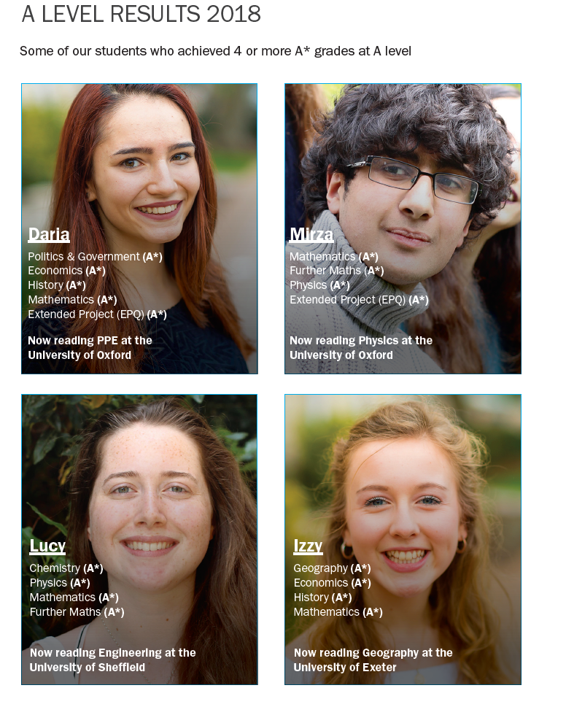
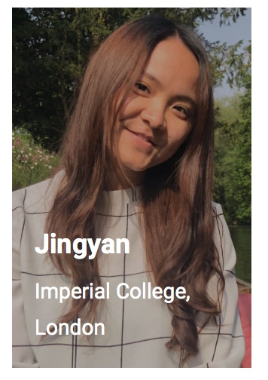

Slide 5
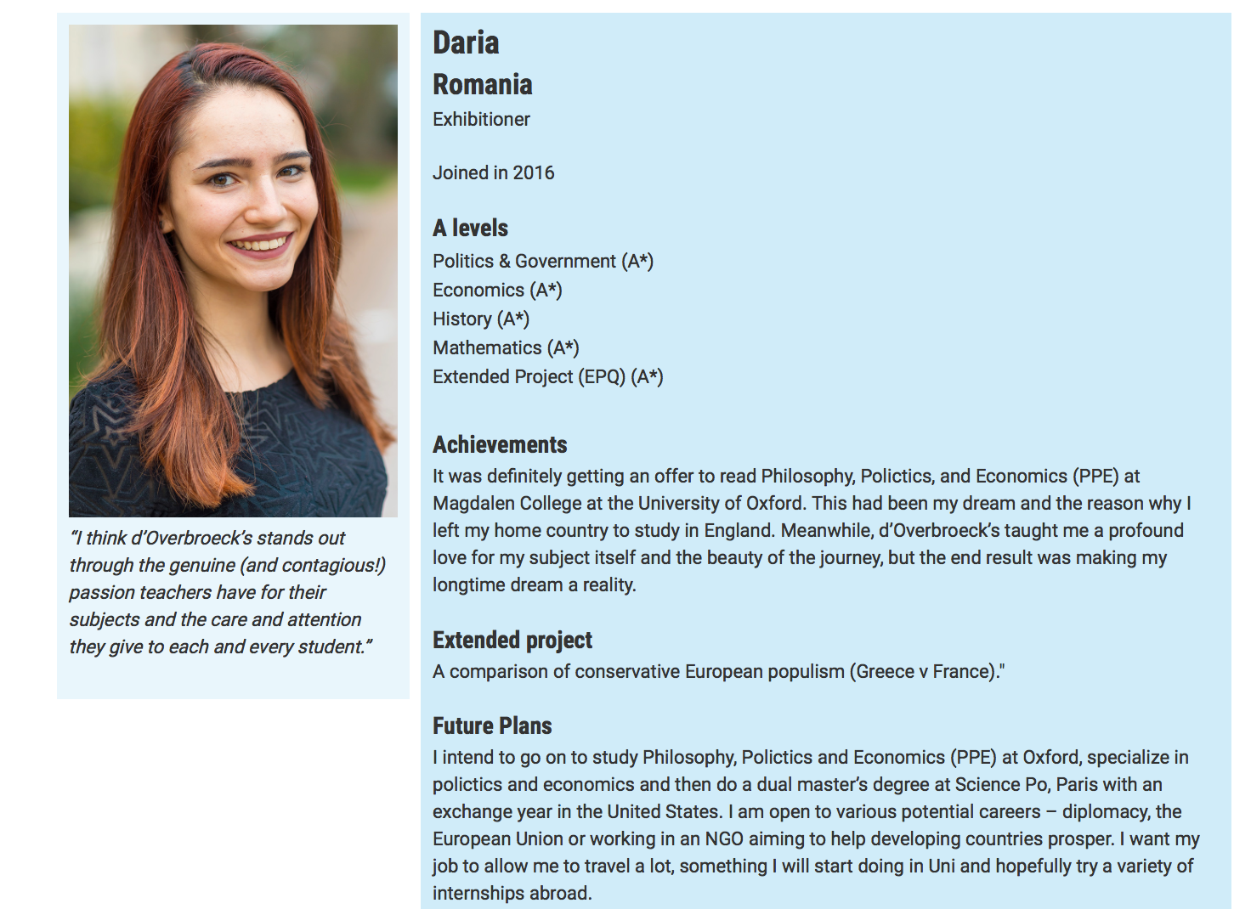

Slide 6
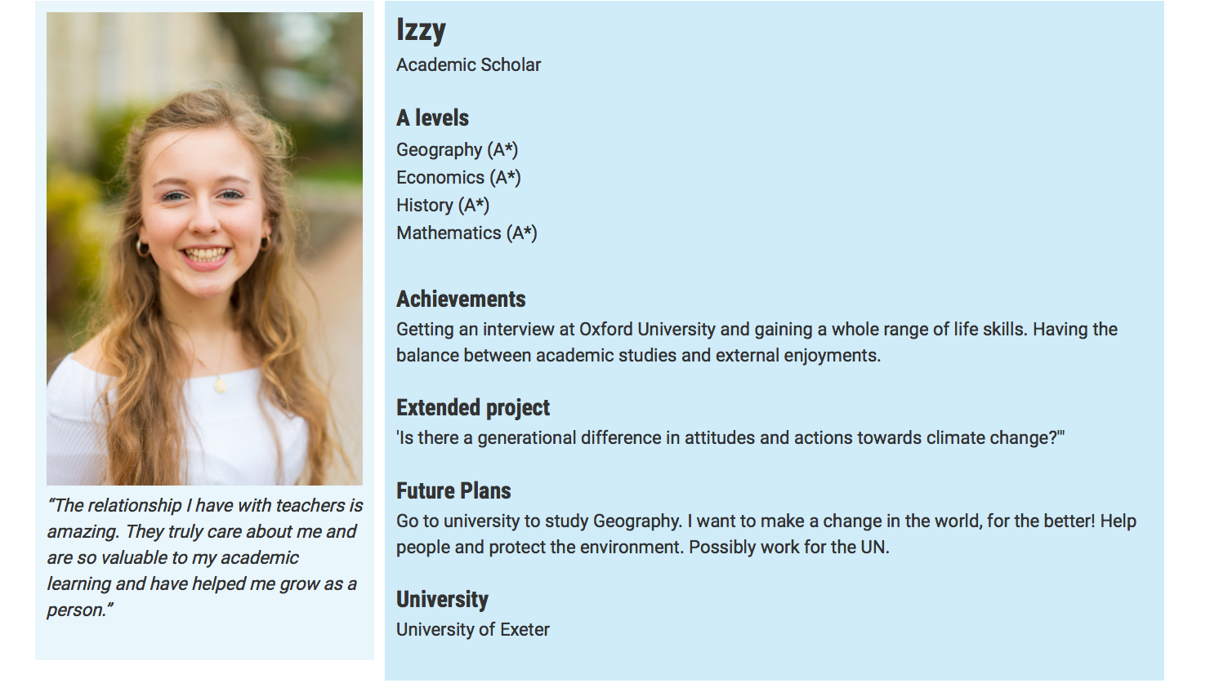

Slide 7
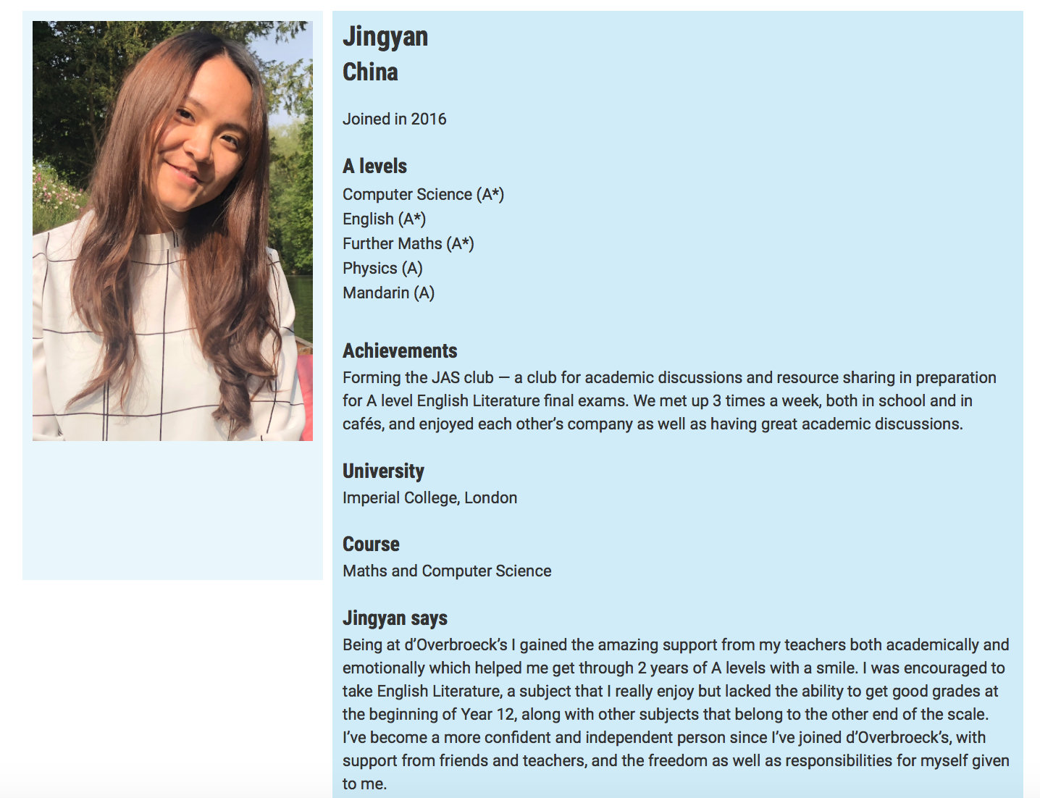

Slide 8
Students learn
At d’Overbroeck’s
Small classes (max 10)
To work collaboratively
To be global in their perspective
To think critically and creatively
To seize opportunities
To enjoy their studies
To learn how to learn
To achieve high grades
UK and international students
Active learning
Curriculum design
Subject choice
Teaching approach
Expert teaching

Slide 10
University destinations d’Overbroeck’s students 2018
 | University
1 | UCL
2 | Exeter
3 | University of Bath
4 | Leeds
5 | City
6 | University of Oxford
7 | University of Bristol
8 | Imperial
9 | Kings College, London
10 | LSE

Slide 11
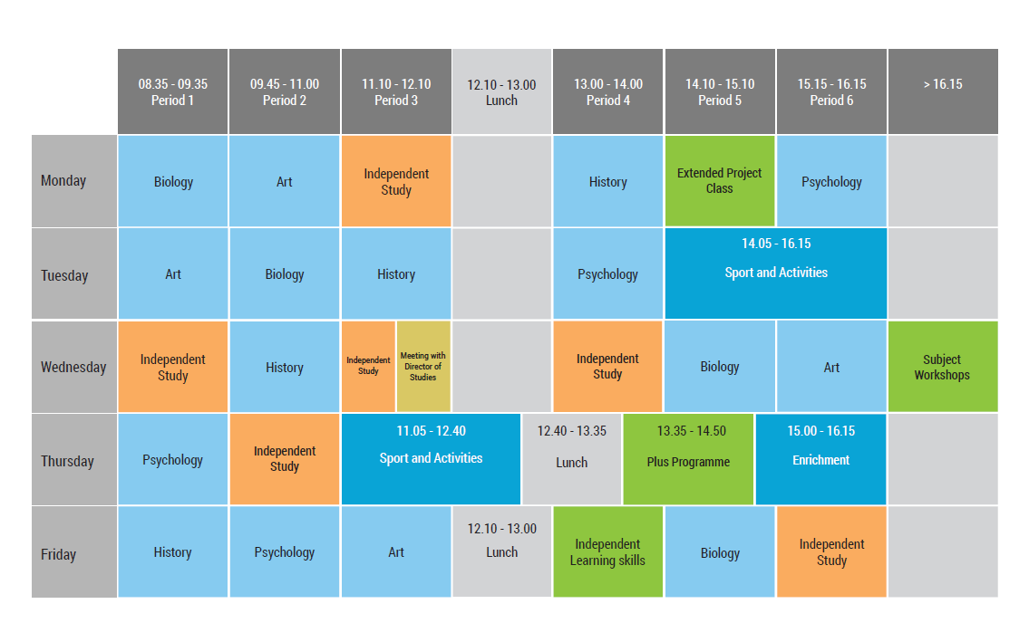
Typical week at d’Overbroeck’s Sixth Form

Slide 12
Sports and activities this term at d’Overbroeck’s
Art Club
Auditioned Choir - Gaudeamus
Badminton
Basketball
Board Games
Chess
Cookery
Dance
Debating
Economics Society
Film Club
First Aid
Football 5aside
Football Squad Training
Golf
Gym
Gym
Hockey
Judo
Knitting
Mindfulness
Model UN
Music Technology
Netball
Orchestra
Photography
Polo (Horse)
Production - Music
Production - Music
Production - Drama
Production - Drama
Robotics
Rock Climbing
Running
Social Studies Discussion
Spinning
STEM
Swimming
Tennis
Yoga

Slide 13
Busy social programme: this term at d’Overbroeck’s
Getting to know Oxford; Saturday 8 September
Activities afternoon at St Philips: Sunday 9 September
Welcome BBQ and activities: Friday 14
Thriller Live- Theatre Trip: Thursday 20 September
London Sightseeing Trip: Saturday 22 September
Thorpe Park : Saturday 13 October
Fireworks at South Park : Saturday 3 November
Bicester Village Shopping Trip: Sunday 11 November
Fantastic Beasts: The Crimes of Grindelward – Cinema trip: Friday 16 Nov
Winter Concert : Tuesday 20 November
Bath Christmas Markets : Saturday 1 December
Dirty Dancing – Theatre Trip : Wednesday 5 December
Christmas Jumper Day & Christmas Lunch: Thursday 13 December

Slide 14
Thank you

